Slide 1
Sprint 1 Status Update
Problem Definition
Team Prophecy
Week # 1
1/29/2023

Slide 2
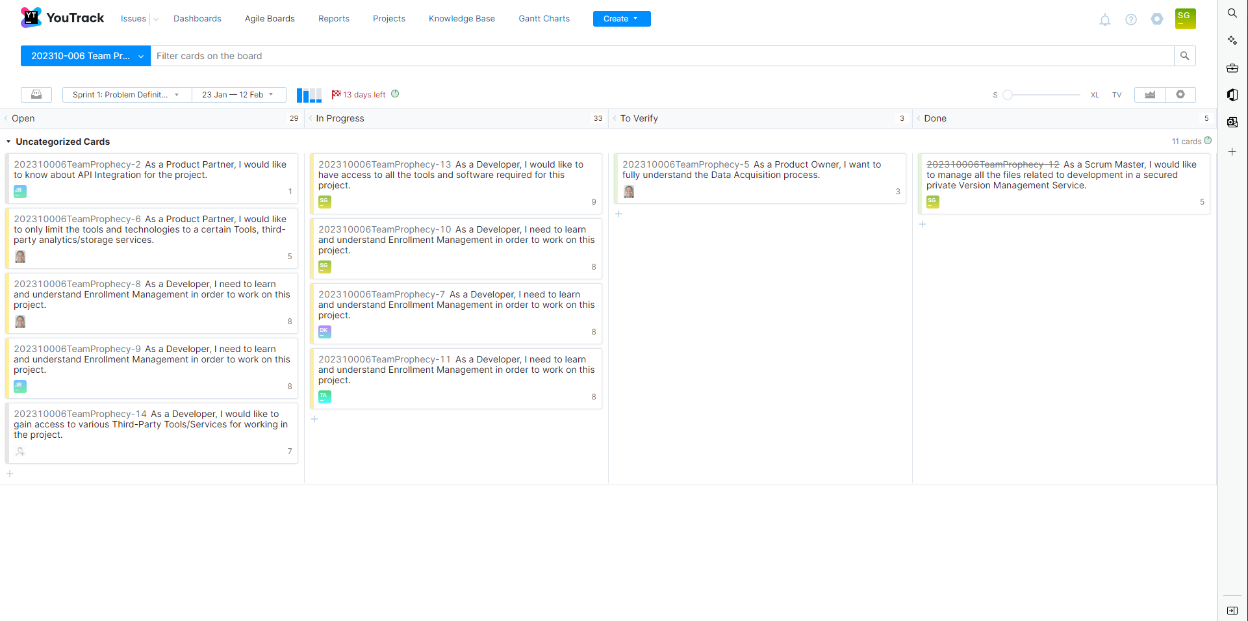
YouTrack
Instructions: SCRUM Master will bring up YouTrack Project page and show Sprint 1 Board
Work with instructor prior to mid-sprint-1 presentation to define all user stories and tasks
All user stories must have a description, exit criteria, assigned to team member, and priority
All user story associated tasks must a description, exit criteria, assigned to team member, and priority
SCRUM Master will be responsible for placing task in the “In Progress” column when ready;
Assigned team member to task is responsible for placing comments and attachment in the task; this will be reviewed by the team member assigned to verify the task and instructor; part of sprint grade
Assigned team member to task moves task to “To Verify” column with task is complete assigns team member to verify the task
Assigned team member to verify task will review the task and either move it to “Done” column if it satisfies exit criteria or moves it back to “In Progress” column with comments why if failed and reassigns to previous task assignee

Slide 3
team Members
Sagar Goswami Scrum Master
Telina Andrianaivo Developer
Erick A Torres Product Owner
Darvik Kunal Banda Developer
Joe B Brock Developer

Slide 4
problem statement
Problem Context:
Domain of problem:
Education
Management
Resource Allocation
Importance of problem:
Students are not able to enroll for courses.
Students have to defer graduation, if they do not get their desired courses.
International Students have to settle with other courses, to maintain Full Course Load.
Departments faces problem in finding the resources to allocate more course sections in the very short time.
Problem Statement:
Analyze the Student Course Enrollment Data
Predict the demand for CEC courses in the upcoming semesters
Train, test and compare various algorithms to find the model which makes the most accurate predictions
Publish the predictions in a report, for easier access to end user.

Slide 5
Datasets
Proposed Datasets for Project [for each dataset]
Dataset Name:
Dataset Owner: Enrollment Management, Office of the Provost
Dataset Type: Proprietary
Dataset Size: Data Extraction in progress…

Slide 6
Potential Analytics/algorithms
Analytic/Algorithm Name: Time-Series/ARIMA, Deep Learning, Linear Programming
Datasets: Course Enrollment Activity
Computer Resources Required: Laptop, GPU Compute Clusters, Cloud Service Platform
Training: if applicable
Optimization: if applicable
Testing: if applicable

Slide 7
Project Schedule
Gather Requirements
Domain Research
Data Acquisition, Cleaning, and Wrangling
Testing ML Models and Algorithms
Comparing and Choosing best performing Model
Post Analysis and Hypothesis Testing
Predictions and Deployment
Automation

Slide 8
Risks and Planned Mitigations
Risk Name | Description | Probability | Impact | Mitigation
Miscommunication | The team gets confused as to what is expected | Medium | High | Ensure all see the YouTrack and monitor WhatsApp
Commitment | Some members have more time than others. | Low | Medium | Balance workload on availability

Slide 9
Weekly Partner Meeting
Partner name Enrollment Management, Office of the Provost
Team Tasks for Current Week
Gather Requirements
Minimum Viable Product
Supplementary Submissions
Acquire and configure resources
Other Items Discussed
Importance of the project to the stakeholders
Need Predictions
1-2 years in the future
Focusing on CEC Courses
Recent issues and steps taken to address these issues
Tools and Services used by the Product Partner
Microstrategy
Microsoft 365
Tableau
Python

Slide 10
Sprint 2 Status Update
Datasets
Team Name
Week #
Date

Slide 11
YouTrack
Instructions: SCRUM Master will bring up youTrack Project page and show Sprint 2 Board
Work with instructor prior to mid-sprint-2 presentation to define all user stories and tasks
All user stories must have a description, exit criteria, assigned to team member, and priority
All user story associated tasks must a description, exit criteria, assigned to team member, and priority
SCRUM Master will be responsible for placing task in the “In Progress” column when ready;
Assigned team member to task is responsible for placing comments and attachment in the task; this will be reviewed by the team member assigned to verify the task and instructor; part of sprint grade
Assigned team member to task moves task to “To Verify” column with task is complete assigns team member to verify the task
Assigned team member to verify task will review the task and either move it to “Done” column if it satisfies exit criteria or moves it back to “In Progress” column with comments why if failed and reassigns to previous task assignee

Slide 12
Datasets
Datasets Planned for Project [for each dataset]
Dataset Name:
Dataset Owner:
Dataset Type: [open source, proprietary]
Dataset Size: [e.g., 20 GB]
Dataset License: [e.g., creative commons licenses such as CCO; CC-BY; CC-BY-SA; PDDL; CDLA-Permissive-1.0, etc.]
Dataset Location: [e.g., Internet; media/CD; ]
Dataset Access: [e.g., provide URL; shipping address]
Dataset Restrictions: [e.g., requires training; no restrictions; can only be used for non-profit work; etc.]
Dataset Time Range: [data that has records base on timestamps, provide time range]
Dataset Collection Process: [how is the data collected]
Analytic/Algorithm that will use dataset: [one or more]

Slide 13
Dataset Quality – [dataset name]
Dataset - [Name]: [slide for each dataset]
Completeness–requires that a particular column, element, or class of data is populated and does not feature null values or values in place of nulls (e.g., N/A).
Consistency–something that tests weather one fact is consistent with another.
Uniqueness–are all the entities or attributes within a dataset unique?•Integrity–are all the relationships populated for a particular entity? [e.g., the inability to link related records together may introduce duplication across systems]
Conformity–does the data conform to right conventions and standards?
Accuracy–refers to whether the data values stored for an object are the correct values. To be correct, a data values must be the right value and must be represented in a consistent and unambiguous form. For example, my birth date is December 13, 1941

Slide 14
Risks and Planned Mitigations
Risk Name | Description | Probability | Impact | Mitigation
[meaningful] | [brief] | [high, medium, low] | [high, medium, low] | [brief]

Slide 15
Weekly Partner Meeting
Partner name [Primary Partner POC]
Team Progress from Prior Week
Team Tasks for Current Week
Other Items Discussed
Instructions: Each week the team is expected to meet with their project partner. The project team is expected to take copious notes of the meeting and what was discussed – just as would take place in any consulting services client meeting engagement.
The first partner meeting will be primarily a Q & A session between the partner and the team – with the team asking detailed and probing questions regarding the problem statement and any specialized subject matter knowledge the partner has relative to the problem domain.
Thereafter, project teams should be reporting on three things each week:
Team Progress from Prior Week
Team Tasks for Current Week
Other Items Discussed
This slide summarizes for the rest of the class what the project team presented to the partner – as well as any other items discussed during the meeting.

Slide 16
Sprint 3 Status Update
Algorithms & Analysis / ML Model Exploration & Selection
Team Name
Week #
Date

Slide 17
YouTrack
Instructions: SCRUM Master will bring up youTrack Project page and show Sprint 3 Board
Work with instructor prior to mid-sprint-3 presentation to define all user stories and tasks
All user stories must have a description, exit criteria, assigned to team member, and priority
All user story associated tasks must a description, exit criteria, assigned to team member, and priority
SCRUM Master will be responsible for placing task in the “In Progress” column when ready;
Assigned team member to task is responsible for placing comments and attachment in the task; this will be reviewed by the team member assigned to verify the task and instructor; part of sprint grade
Assigned team member to task moves task to “To Verify” column with task is complete assigns team member to verify the task
Assigned team member to verify task will review the task and either move it to “Done” column if it satisfies exit criteria or moves it back to “In Progress” column with comments why if failed and reassigns to previous task assignee

Slide 18
analytic/algorithm Specification
Name:
How it works: [brief description on the “inner workings of algorithm”
Data Inputs: [include description of data input requirements and any data preparation required, size of input data, data types such as training, testing, etc., e.g., conditioning, transformation, formats, etc.)
Data Outputs: [include description on the data output; how will output data be used]
Hyperparameters:
Model Tuning:
Model Training Resources Required: [CPU, GPU, cloud based, laptop, memory, etc.]
Model Deployment: [how will the trained model be used]

Slide 19
analytics/algorithms - Demonstrations
[provide a demo for each analytic/algorithm be considered]

Slide 20
Risks and Planned Mitigations
Risk Name | Description | Probability | Impact | Mitigation
[meaningful] | [brief] | [high, medium, low] | [high, medium, low] | [brief]

Slide 21
Weekly Partner Meeting
Partner name [Primary Partner POC]
Team Progress from Prior Week
Team Tasks for Current Week
Other Items Discussed
Instructions: Each week the team is expected to meet with their project partner. The project team is expected to take copious notes of the meeting and what was discussed – just as would take place in any consulting services client meeting engagement.
The first partner meeting will be primarily a Q & A session between the partner and the team – with the team asking detailed and probing questions regarding the problem statement and any specialized subject matter knowledge the partner has relative to the problem domain.
Thereafter, project teams should be reporting on three things each week:
Team Progress from Prior Week
Team Tasks for Current Week
Other Items Discussed
This slide summarizes for the rest of the class what the project team presented to the partner – as well as any other items discussed during the meeting.

Slide 22
Sprint 4 Status Update
Visualizations / ML Model Training, Evaluation, & Verification
Team Name
Week #
Date

Slide 23
YouTrack
Instructions: SCRUM Master will bring up youTrack Project page and show Sprint 4 Board
Work with instructor prior to mid-sprint-4 presentation to define all user stories and tasks
All user stories must have a description, exit criteria, assigned to team member, and priority
All user story associated tasks must a description, exit criteria, assigned to team member, and priority
SCRUM Master will be responsible for placing task in the “In Progress” column when ready;
Assigned team member to task is responsible for placing comments and attachment in the task; this will be reviewed by the team member assigned to verify the task and instructor; part of sprint grade
Assigned team member to task moves task to “To Verify” column with task is complete assigns team member to verify the task
Assigned team member to verify task will review the task and either move it to “Done” column if it satisfies exit criteria or moves it back to “In Progress” column with comments why if failed and reassigns to previous task assignee

Slide 24
Visualizations
[provide a series of visualizations for results based on sprint 3 work; these visualization should provide the audience with insights into your findings that will support your problem solution; it is important to discuss findings that are incorrect or not useful and findings that support the problem solution]

Slide 25
Risks and Planned Mitigations
Risk Name | Description | Probability | Impact | Mitigation
[meaningful] | [brief] | [high, medium, low] | [high, medium, low] | [brief]

Slide 26
Weekly Partner Meeting Update
Partner name [Primary Partner POC]
Team Progress from Prior Week
Team Tasks for Current Week
Other Items Discussed
Instructions: Each week the team is expected to meet with their project partner. The project team is expected to take copious notes of the meeting and what was discussed – just as would take place in any consulting services client meeting engagement.
The first partner meeting will be primarily a Q & A session between the partner and the team – with the team asking detailed and probing questions regarding the problem statement and any specialized subject matter knowledge the partner has relative to the problem domain.
Thereafter, project teams should be reporting on three things each week:
Team Progress from Prior Week
Team Tasks for Current Week
Other Items Discussed
This slide summarizes for the rest of the class what the project team presented to the partner – as well as any other items discussed during the meeting.

Slide 27
Sprint 5 Status Update
Final Report & Showcase Presentation Preparation
Team Name
Week #
Date

Slide 28
Team Name — YouTrack
Instructions: SCRUM Master will bring up youTrack Project page and show Sprint 5 Board
Work with instructor prior to mid-sprint-5 presentation to define all user stories and tasks
All user stories must have a description, exit criteria, assigned to team member, and priority
All user story associated tasks must a description, exit criteria, assigned to team member, and priority
SCRUM Master will be responsible for placing task in the “In Progress” column when ready;
Assigned team member to task is responsible for placing comments and attachment in the task; this will be reviewed by the team member assigned to verify the task and instructor; part of sprint grade
Assigned team member to task moves task to “To Verify” column with task is complete assigns team member to verify the task
Assigned team member to verify task will review the task and either move it to “Done” column if it satisfies exit criteria or moves it back to “In Progress” column with comments why if failed and reassigns to previous task assignee

Slide 29
Risks and Planned Mitigations
Risk Name | Description | Probability | Impact | Mitigation
[meaningful] | [brief] | [high, medium, low] | [high, medium, low] | [brief]

Slide 30
Weekly Partner Meeting
Partner name [Primary Partner POC]
Team Progress from Prior Week
Team Tasks for Current Week
Other Items Discussed
Instructions: Each week the team is expected to meet with their project partner. The project team is expected to take copious notes of the meeting and what was discussed – just as would take place in any consulting services client meeting engagement.
The first partner meeting will be primarily a Q & A session between the partner and the team – with the team asking detailed and probing questions regarding the problem statement and any specialized subject matter knowledge the partner has relative to the problem domain.
Thereafter, project teams should be reporting on three things each week:
Team Progress from Prior Week
Team Tasks for Current Week
Other Items Discussed
This slide summarizes for the rest of the class what the project team presented to the partner – as well as any other items discussed during the meeting.

